Slide 1
Unit Two – Principles of Rehabilitation
Lesson One: Common Rehab Terminology

Slide 2
Introduction
We have discussed several medical terms. Which do you remember best?
What medical terms do you think apply more specifically to rehabilitation? List as many as you can!
What are you most excited to learn about regarding muscle rehab?

Slide 3
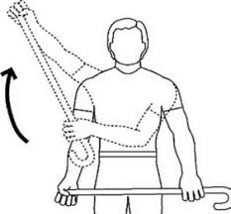
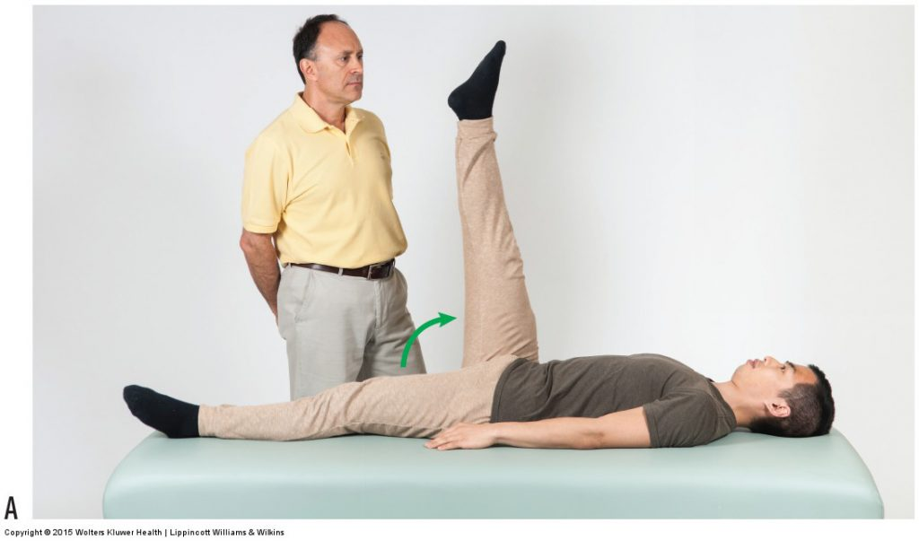
Almost ALL the Rehabilitation Terminology _{(You Don’t Already Know)}
Active Assistive Range of Motion
Range of motion that is performed with a combination of voluntary activity of the muscles & passive assistance from an outside source
Active ROM
The amount of movement produced at a joint by the patient without assistance
Agility
The ability to control the direction of a body or its parts during rapid movement

Slide 4
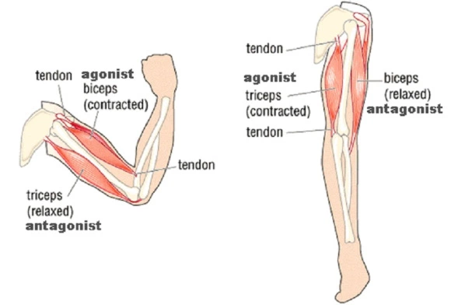
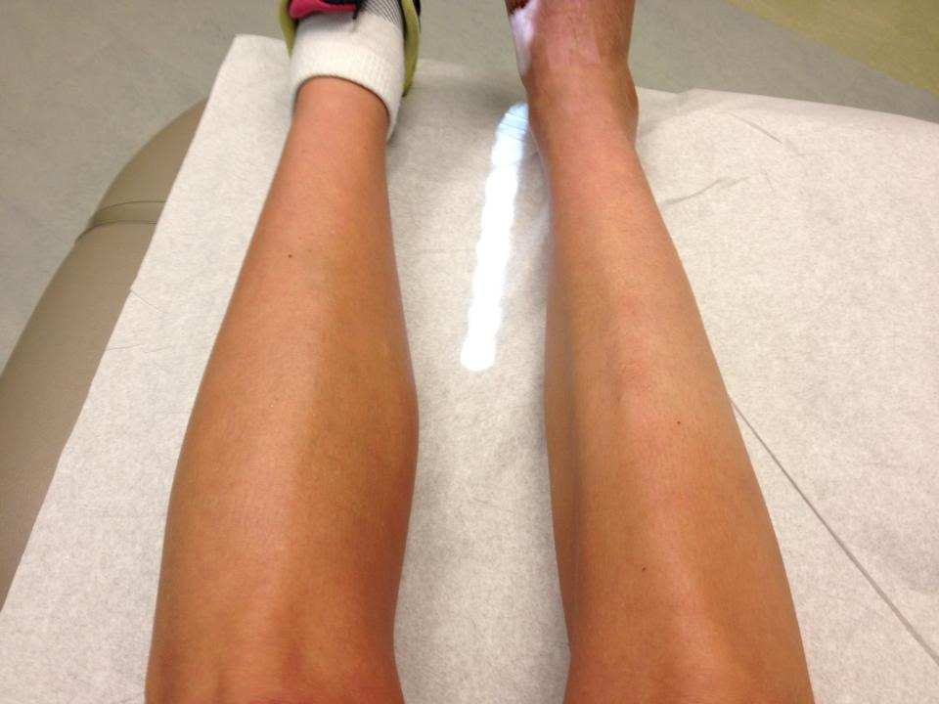
Agonist
A muscle acting as a prime mover to produce a motion
Antagonist
A muscle that opposes the motion of another muscle
Atrophy
Wasting away of tissue with a decrease in size & strength, especially from lack of use
Balance
The body’s ability to maintain an equilibrium by controlling the body’s center of gravity over its base of support
Body Mechanics
The way the body is positioned & used during activity

Slide 5
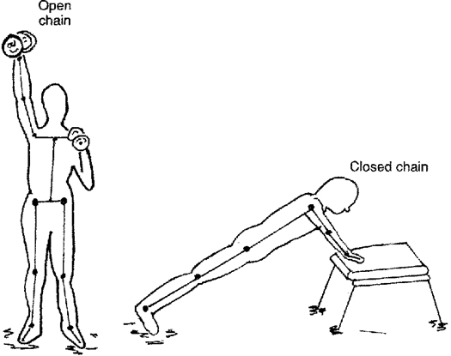
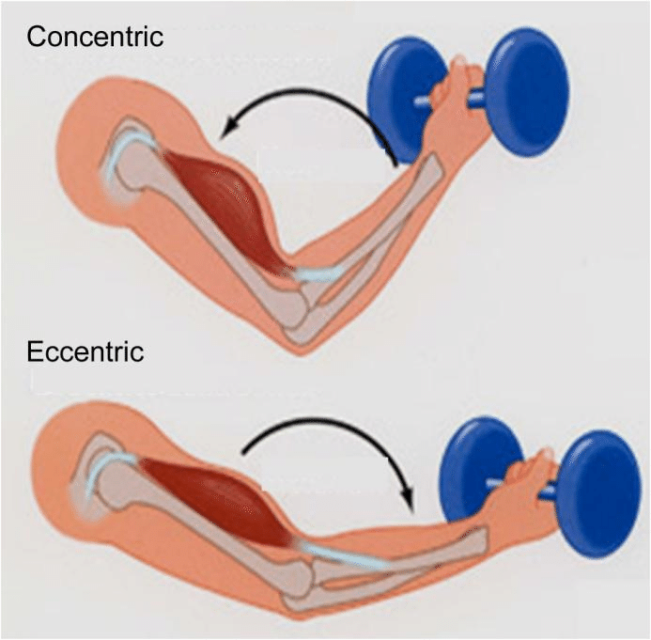
Closed Kinetic Chain
A motion in which the distal segment of an extremity is weight bearing & the body moves over the hand or foot
Concentric Motion
Dynamic activity in which the muscle shortens
Coordination
The ability of muscles & muscle groups to perform complicated movements
Dynamic Activity
Activity in which movement occurs
Eccentric Motion
A dynamic activity in which the muscle lengthens

Slide 6
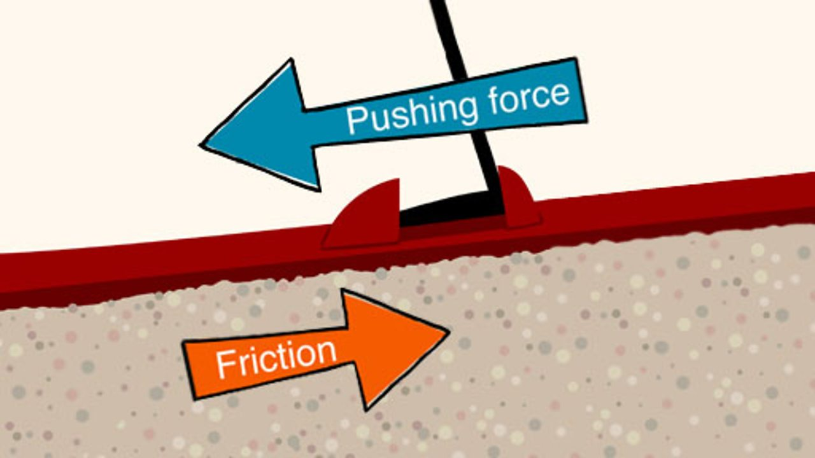
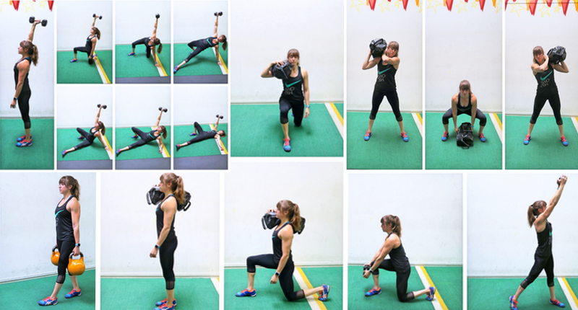
Flexibility
Mobility of a body segment, dependent on soft tissue tolerance to movement & the ability of soft tissue to move with forces applied to it
Force
A strength or energy that causes movement & has direction & magnitude
Friction
Resistance to movement between two surfaces
Functional Exercise
Activities that mimic the stresses, demands, & skills of the sport & advance a patient toward a safe & prompt return to sport participation

Slide 7
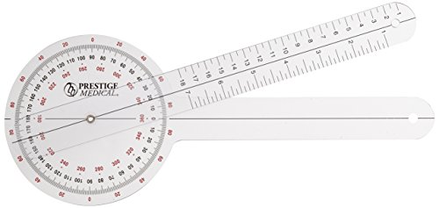
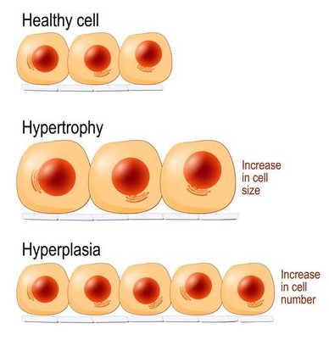
Goniometer
A tool used to measure joint range of motion
Hypertrophy
An increase in muscle bulk from an increase in the size of the muscle fibers, NOT the number of muscle fibers
Manipulation
Passive joint movement used to increase joint mobility. It incorporates a sudden, forceful thrust that is beyond the patient’s control
Manual Therapy
The use of hands-on techniques for evaluating, treating, & improving the status of neuromusculoskeletal conditions

Slide 8
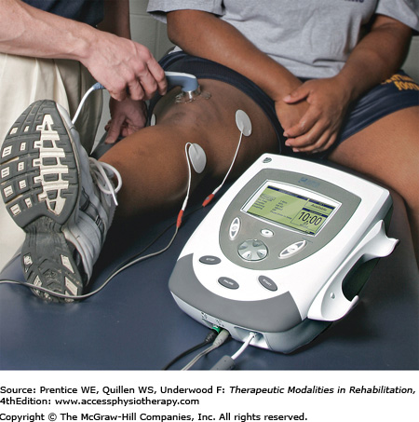
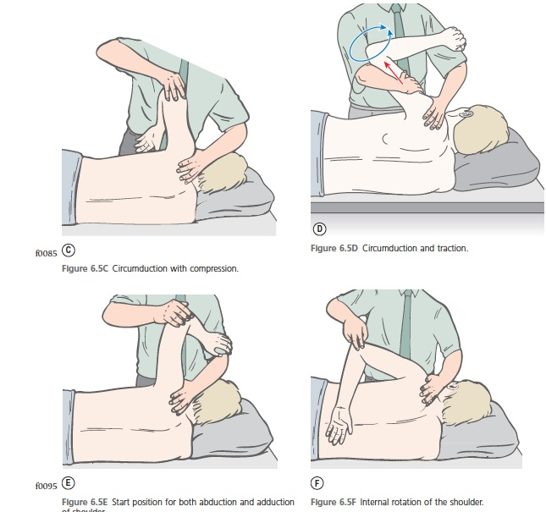
Modality
A physical agent used to relieve pain, improve circulation, reduce spasm, & promote healing
Muscle Energy
A manual therapy technique using precisely applied active muscle contraction against a counterforce to correct alignment & improve function
Muscle Energy Technique
The use of muscle contraction to precipitate a correction of a joint’s malalignment
Open Kinetic Chain
A motion in which the distal segment of an extremity moves freely in space

Slide 9
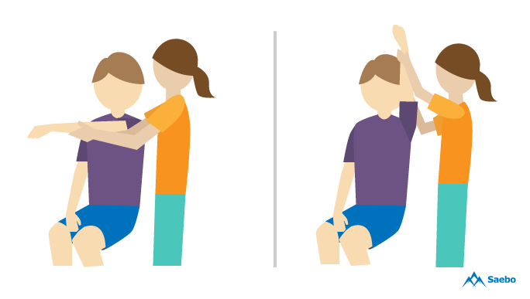
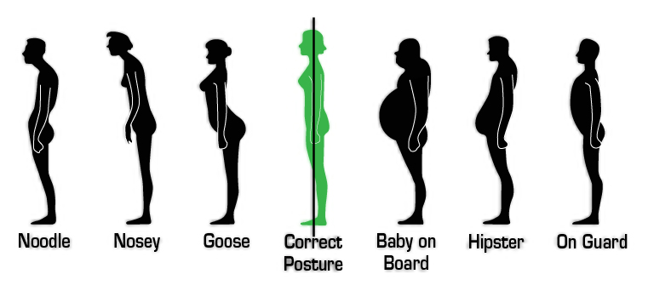
Passive Range of Motion/Passive Psychological ROM
The amount of range of motion achieved without the assistance of the patient
Physiological Advantage
A muscle’s ability to shorten. A muscle has its greatest physiological advantage when at its resting length
Plan of Treatment Program
The components, frequency, & duration of a treatment program. Includes the establishment of short-term & long-term goals
Posture
The relative alignment of the various body segments with one another

Slide 10
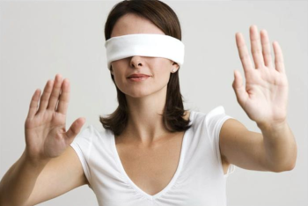
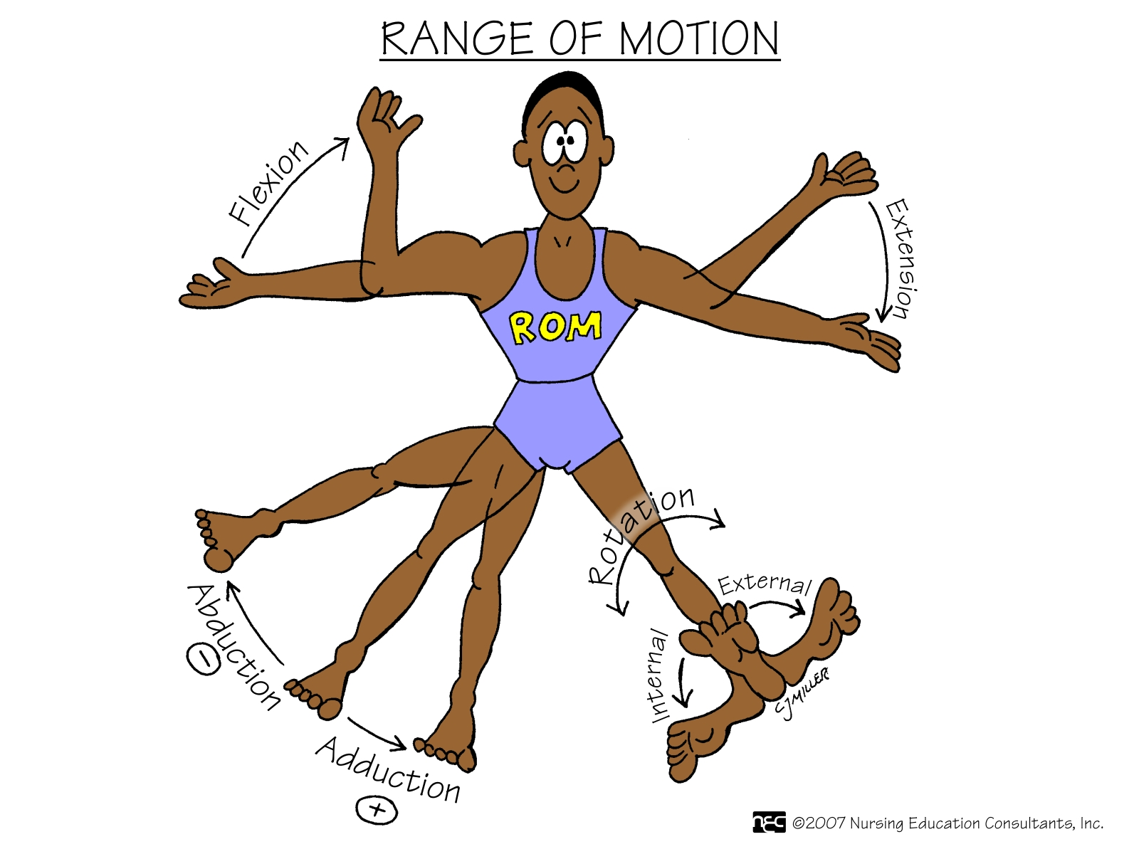
Proprioception
The body’s ability to transmit afferent information regarding position sense, to interpret the information, & to respond consciously or unconsciously to stimulation through appropriate execution of posture & movement
The ABC’s of proprioception are agility, balance, & coordination
Proprioceptive Neuromuscular Facilitation (PNF)
A combined movement pattern that uses neural stimulation to facilitate a proper muscle response
Range of Motion
Amount of movement within a joint. ROM is affected by soft tissue mobility & can be influenced by strength when performed actively

Slide 12
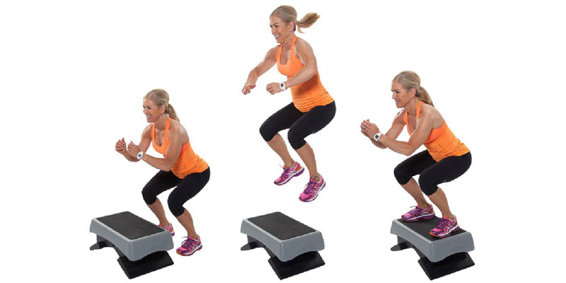
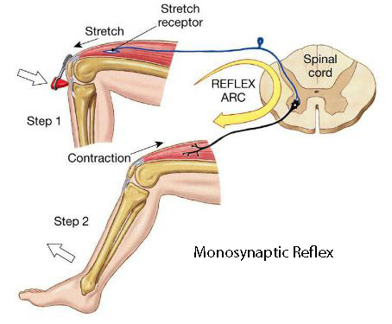
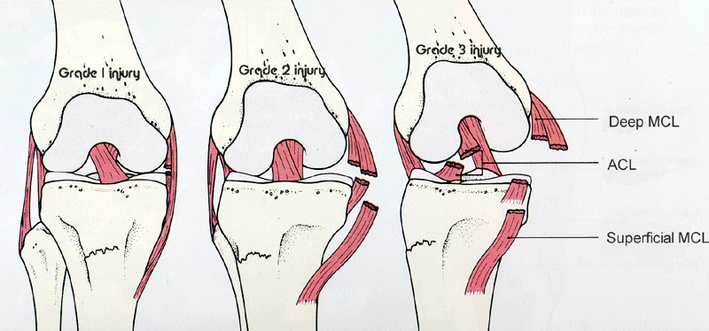
Stretch-Shortening Exercise/Plyometrics
An exercise that makes use of the elastic properties of a muscle, using a lengthening of a muscle followed by a sudden shortening to produce increased power
Stretch Reflex
The most basic sensorimotor response…goes directly from the afferent sensory nerve (muscle spindle) to the spinal cord, where it makes contact with the motor nerve to permit a muscle response
Tensile strength
Maximal amount of stress a structure is able to withstand before tissue failure occurs. Tensile strength varies as tissue healing proceeds

Slide 13
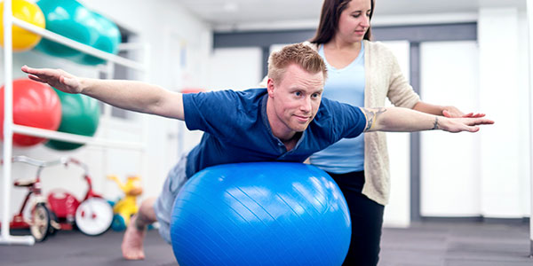
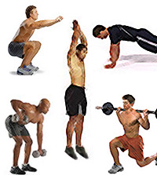
Therapeutic Exercise vs. Conditioning Exercise
Therapeutic exercise is a medical term used to describe prescribed exercises that are used in a rehab program with the purpose of restoring normal body function.
Usually these exercises are only used regarding injuries or chronic disorder.
Conditioning exercises are…everything else!
Think athletics & general strength gains.

Slide 14
Components of a Rehabilitation Program
Minimizing swelling
Controlling pain
Reestablishing neuromuscular control
Establishing or enhancing core stability
Regaining or improving range of motion
Restoring or increasing muscular strength & endurance
Regaining balance & postural control
Maintaining cardiorespiratory endurance
Incorporating functional progressions

Slide 15
What are the CHRONOLOGICAL steps of the RTP process?
Immobilization
Range of Motion
Basic Strength
Balance, Speed, Power, and Agility
Sport Specific Function
Partial Return to Play
Full Return to Play
How do these two processes fit together?

Slide 16
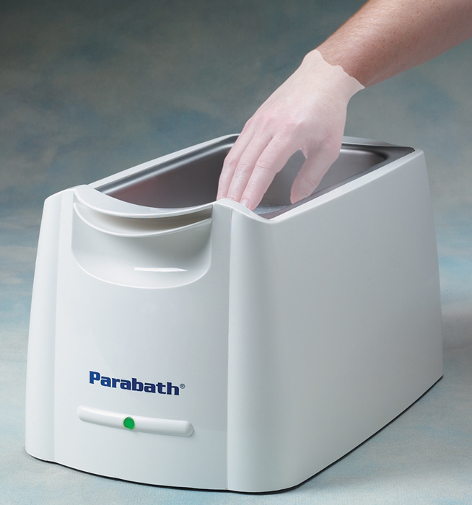
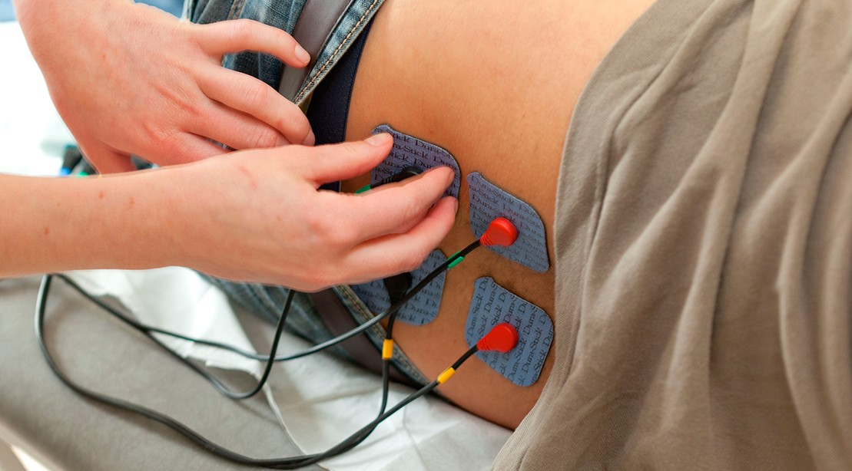
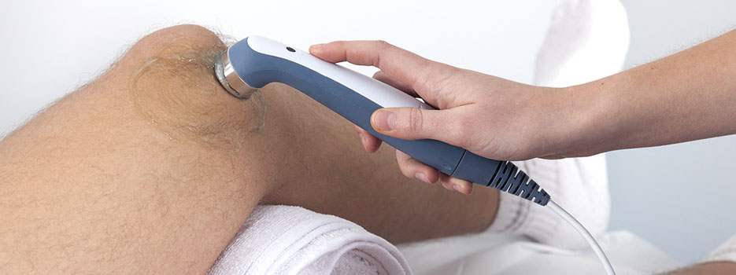
What different types of therapy do we incorporate?
Thermotherapy
Heat packs
Warm whirlpool
Paraffin bath
Cryotherapy
Ice bag
Ice bath
Ice massage
Electrotherapy
E-stim/TENS
Sound Therapy
Ultrasound

Slide 17
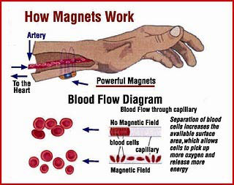
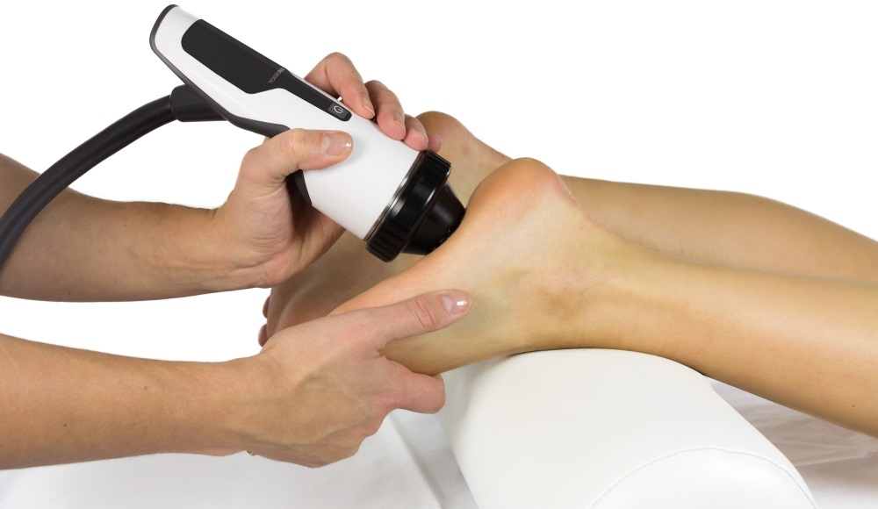
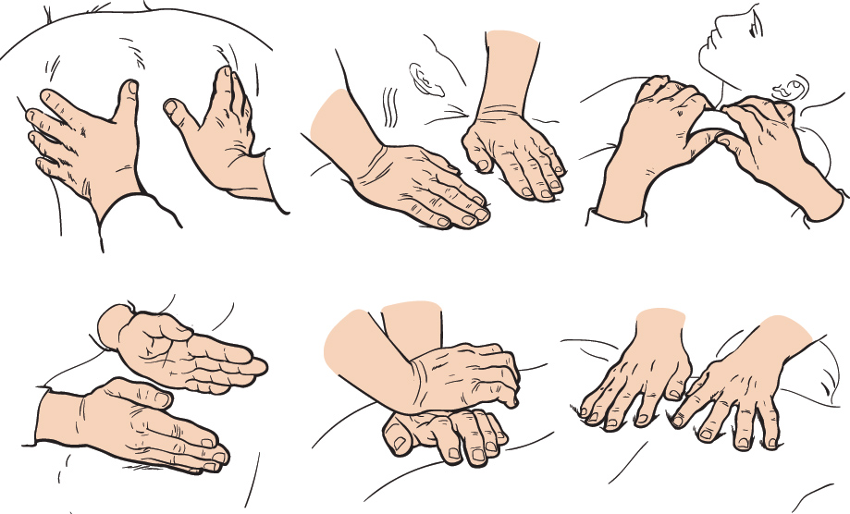
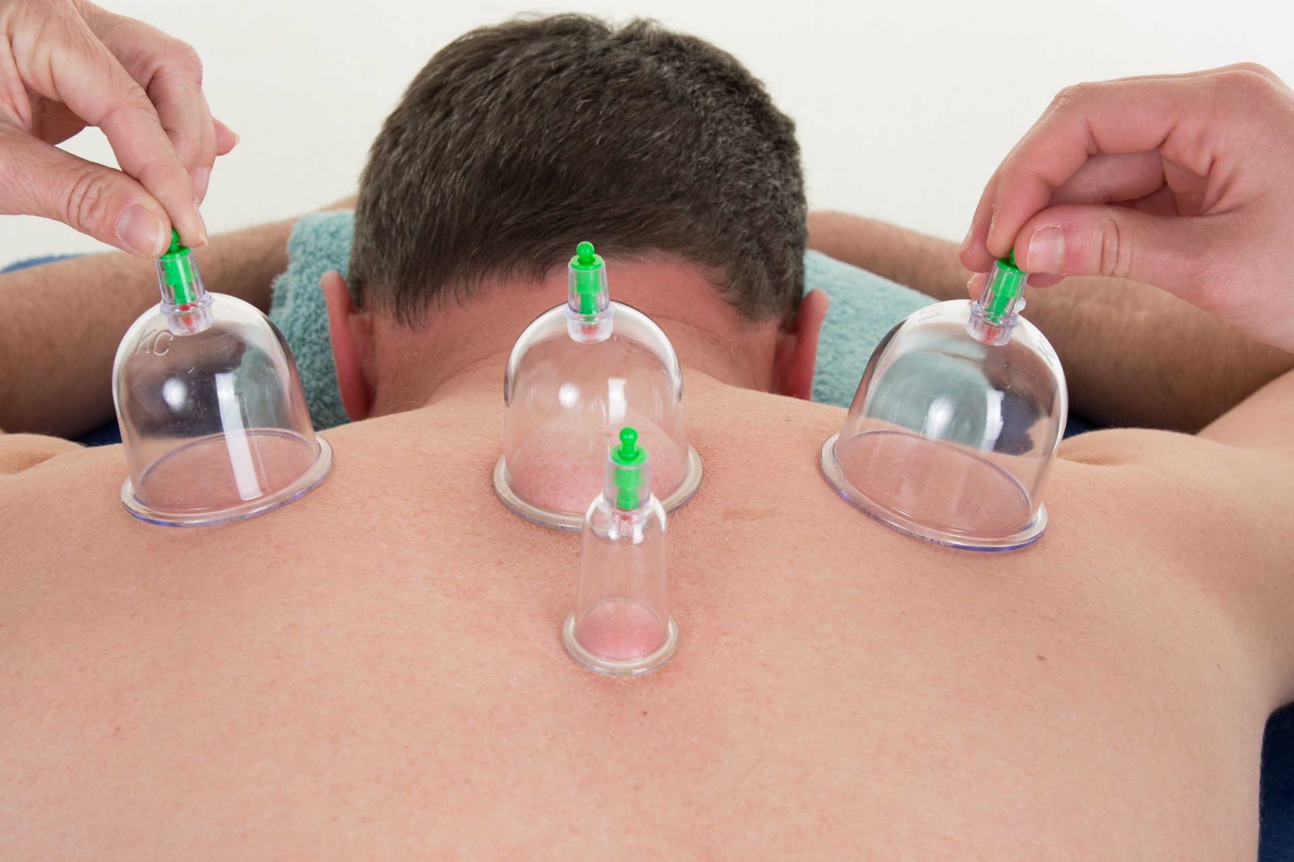
And those we typically don’t…
Magnet therapy
A magnet field is applied around the body to theoretically “attract particles of opposite charge and repel particles of similar charge”
Possible effects are changed polarization of a damaged cell, increased blood flow & oxygen saturation, increased muscle strength, etc.
Extracorporeal Shock Wave Therapy
EXPENSIVE! Painful, & risky during pregnancy, adolescence, around tumors, or around open wounds.
Type of sound therapy
Cupping Therapy
Massage

Slide 18
Exit Card – Parking Lot! Write down your thoughts on a sticky note, make sure your name is on it somewhere so you get your points, & stick on the poster!
**FOR TEN POINTS**
Write down:
AT LEAST one (if not more) rehab technique that has not been brought up yet that you would like to learn more about!
A question that you would like answered (but are maybe afraid to ask)
Or something that you learned today!
☺

